Slide 1
Big Data Analysis for NYPD Shooting Incident

Slide 2
Prepared By
Wiwat Thaphon : 101448037
Sujay : 101446631
Ryan : 101506979
Rohit : 101492504
Shiva : 101503674

Slide 3
Agenda
Introduction
Objective
Datasets
Methodology
Insights and Recommendations

Slide 4
Introduction
Using Big Data Tools for managing large datasets is crucial for studying and analyzing data in increasingly complex formats. This project focuses on importing and analyzing data from various sources using diverse tools and technologies to establish relationships and conduct deep data analysis.
Utilizing Big Data Tools such as Hadoop, Apache Spark for managing and importing large datasets from various sources into databases like MySQL, MongoDB to systematically and systematically store data from various sources.
Using Power BI to create reports and visualize data obtained from Big Data Tools using diverse data.
Using Big Data Tools to link data from various sources, such as using Spark for processing and querying data from multiple sources.

Slide 5
Objectives of the Analysis
01
04
Uncover trends in shooting incidents
Inform strategies for violence reduction and public safety
Identify long-term patterns and changes in shooting incidents over time.
Develop targeted interventions and strategies to reduce violence and enhance safety.
02
05
Identify geographical and temporal patterns
Provide actionable insights for law enforcement
Map and analyze the locations and times of shooting incidents to find hotspots.
Deliver data-driven recommendations to improve law enforcement operations against gun violence.
03
06
Analyze demographic influences and external factors
Enhance data-driven policy development
Support policymakers with robust evidence for informed decision-making.
Examine correlations between demographic groups, external factors, and shooting incidents.

Slide 6
Data Sources
Arrest Year to Date
Arrest Historic
ARREST_KEY: A unique identifier for each arrest record.
ARREST_DATE: The date on which the arrest took place.
PD_DESC: A description of the offense as defined by the New York Police Department (NYPD).
OFNS_DESC: The specific offense description (similar to PD_DESC but possibly more detailed).
LAW_CODE: The specific section of the New York Penal Law that was violated.
LAW_CAT_CD: The category of the offense, such as felony (F), misdemeanor (M), or violation (V).
AGE_GROUP: The age group of the person arrested (e.g., "<18", "18-24", "25-44", "45-64", "65+").
PERP_SEX: The gender of the person arrested (e.g., "M" for male, "F" for female).
ARREST_KEY: A unique identifier for each arrest record.
ARREST_DATE: The date on which the arrest took place.
PD_DESC: A description of the offense as defined by the New York Police Department (NYPD).
KY_CD: A code corresponding to the offense description.
LAW_CODE: The specific section of the New York Penal Law that was violated.
LAW_CAT_CD: The category of the offense, such as felony (F), misdemeanor (M), or violation (V).
AGE_GROUP: The age group of the person arrested (e.g., "<18", "18-24", "25-44", "45-64", "65+").
PERP_SEX: The gender of the person arrested (e.g., "M" for male, "F" for female).

Slide 7
Data Sources(Cont..)
Job NYC Posting
Covid 19
Job_ID: A unique identifier for each job posting.
Agency: The city agency or organization that posted the job.
Posting_Type: Indicates whether the posting is internal (for current city employees) or external (open to the general public).
#_Of_Positions: The number of positions available for the job.
Business_Title: The title or designation of the job position.
Civil_Service_Title: The official civil service title associated with the job.
Title_Code_No: The code number associated with the job title.
DATE_OF_INTEREST: The date of the reported COVID-19 data.
CASE_COUNT: The number of confirmed COVID-19 cases reported on that date.
HOSPITALIZED_COUNT: The number of COVID-19 patients hospitalized on that date.
DEATH_COUNT: The number of deaths attributed to COVID-19 reported on that date.
CASE_COUNT_7DAY_AVG: The 7-day average of confirmed COVID-19 cases, smoothing out daily fluctuations.
HOSP_COUNT_7DAY_AVG: The 7-day average of COVID-19 hospitalizations.
DEATH_COUNT_7DAY_AVG: The 7-day average of COVID-19 deaths.

Slide 8
Data Sources(Cont..)
Shooting Incident Year To Date
Shooting Incident Historic
INCIDENT_KEY: A unique identifier for each shooting incident.
OCCUR_DATE: The date when the shooting incident occurred.
OCCUR_TIME: The time when the shooting incident occurred.
BORO: The borough where the shooting incident took place (e.g., Manhattan, Bronx, Brooklyn, Queens, Staten Island).
PRECINCT: The NYPD precinct associated with the location of the shooting incident.
JURISDICTION_CODE: The code indicating the jurisdiction where the shooting incident occurred (e.g., NYPD, Transit, Housing).
LOCATION_DESC: A description of the location where the shooting incident occurred (e.g., street address, park, housing complex).
STATISTICAL_MURDER_FLAG: A flag indicating whether the shooting incident resulted in a homicide (0 = no, 1 = yes).
INCIDENT_KEY: A unique identifier for each shooting incident.
OCCUR_DATE: The date when the shooting incident occurred.
OCCUR_TIME: The time when the shooting incident occurred.
BORO: The borough where the shooting incident took place (e.g., Manhattan, Bronx, Brooklyn, Queens, Staten Island).
PRECINCT: The NYPD precinct associated with the location of the shooting incident.
JURISDICTION_CODE: The code indicating the jurisdiction where the shooting incident occurred (e.g., NYPD, Transit, Housing).
LOCATION_DESC: A description of the location where the shooting incident occurred (e.g., street address, park, housing complex).
STATISTICAL_MURDER_FLAG: A flag indicating whether the shooting incident resulted in a homicide (0 = no, 1 = yes).

Slide 9
Data Sources(Cont..)
Motor Vehicle Crash
Motor Vehicle
ICRASH_DATE: The date when the motor vehicle crash occurred.
CRASH_TIME: The time when the motor vehicle crash occurred.
BOROUGH: The borough where the crash occurred (e.g., Manhattan, Bronx, Brooklyn, Queens, Staten Island).
ZIP_CODE: The ZIP code of the location where the crash occurred.
LATITUDE: The latitude coordinate of the crash location.
LONGITUDE: The longitude coordinate of the crash location.
NUMBER OF PERSONS INJURED: The number of individuals injured in the crash.
NUMBER OF PERSONS KILLED: The number of individuals killed in the crash.
ICRASH_DATE: The date when the motor vehicle crash occurred.
CRASH_TIME: The time when the motor vehicle crash occurred.
BOROUGH: The borough where the crash occurred (e.g., Manhattan, Bronx, Brooklyn, Queens, Staten Island).
ZIP_CODE: The ZIP code of the location where the crash occurred.
LATITUDE: The latitude coordinate of the crash location.
LONGITUDE: The longitude coordinate of the crash location.
CONTRIBUTING_FACTOR_VEHICLE_1, 2, etc.: Factors contributing to the collision, as reported for each involved vehicle.
VEHICLE_TYPE_CODE_1, 2, etc.: The type of vehicle involved in the collision for each vehicle (e.g., Sedan, SUV, Bicycle).

Slide 10
Methodology
Data Collection and Integration:
Utilize Alteryx for data preparation and integration tasks. Alteryx allows for easy extraction, transformation, and loading (ETL) of data from various sources, including SQL Server Express, Azure SQL, MongoDB, MariaDB, Hadoop, Snowflake, and other databases.
Extract relevant datasets from different sources and consolidate them for analysis.
Data Warehousing:
Store integrated data in a centralized data warehouse for easy accessibility and scalability.
Use Azure SQL Database or Azure SQL Data Warehouse to store structured data, while utilizing tools like MongoDB or Hadoop for semi-structured or unstructured data storage.
Data Analysis:
Leverage Azure Analysis Services for advanced analytics and OLAP (Online Analytical Processing) capabilities. This allows for multidimensional analysis and exploration of large datasets.
Use PySpark for distributed data processing and analysis, especially when dealing with large-scale datasets stored in Hadoop or Snowflake.

Slide 11
Methodology(Contd..)
Data Visualization:
Visualize insights and analysis results using Power BI, which seamlessly integrates with Azure Analysis Services, SQL Server, and other data sources.
Create interactive dashboards and reports in Power BI to communicate findings effectively to stakeholders.
Iterative Analysis and Feedback Loop:
Continuously iterate on the analysis process based on feedback from stakeholders and evolving business requirements.
Monitor performance metrics and key performance indicators (KPIs) using Power BI dashboards to assess the effectiveness of implemented solutions.

Slide 12
Methodology(Contd..)
Data Visualization:
Visualize insights and analysis results using Power BI, which seamlessly integrates with Azure Analysis Services, SQL Server, and other data sources.
Create interactive dashboards and reports in Power BI to communicate findings effectively to stakeholders.
Iterative Analysis and Feedback Loop:
Continuously iterate on the analysis process based on feedback from stakeholders and evolving business requirements.
Monitor performance metrics and key performance indicators (KPIs) using Power BI dashboards to assess the effectiveness of implemented solutions.

Slide 13
Methodology(Contd..)
Data Visualization:
Visualize insights and analysis results using Power BI, which seamlessly integrates with Azure Analysis Services, SQL Server, and other data sources.
Create interactive dashboards and reports in Power BI to communicate findings effectively to stakeholders.
Iterative Analysis and Feedback Loop:
Continuously iterate on the analysis process based on feedback from stakeholders and evolving business requirements.
Monitor performance metrics and key performance indicators (KPIs) using Power BI dashboards to assess the effectiveness of implemented solutions.

Slide 14
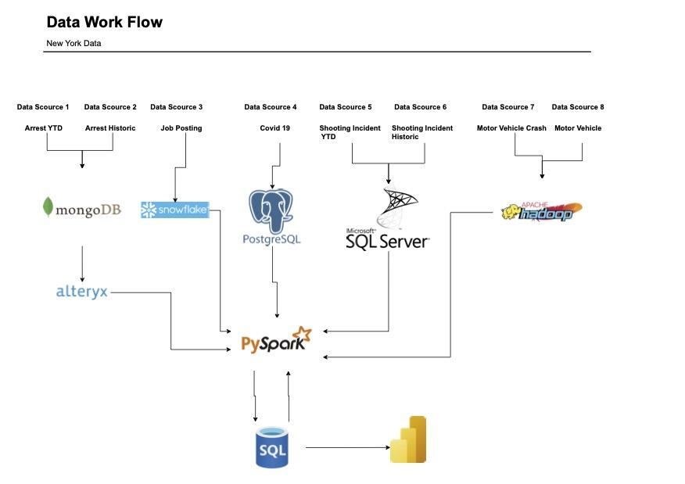
Data Flow & Transformations

Slide 15
Data Flow & Transformations (Contd..)
Dataset | Input type | Technology/tool used
Arrest YTD | MongoDB | Pyspark
Arrest Historic | MongoDB | Pyspark
Job Posting | Snowflake | Pyspark
Covid 19 | PostgreSQL | Pyspark
Shooting Incident YTD | Microsoft SQL server | Pyspark
Shooting Incident Historic | Microsoft SQL server | Pyspark
Motor Vehicle Crash | Hadoop | Pyspark
Motor Vehicle Vehicle | Hadoop | Pyspark

Slide 16

Power BI Visualizations

Slide 17
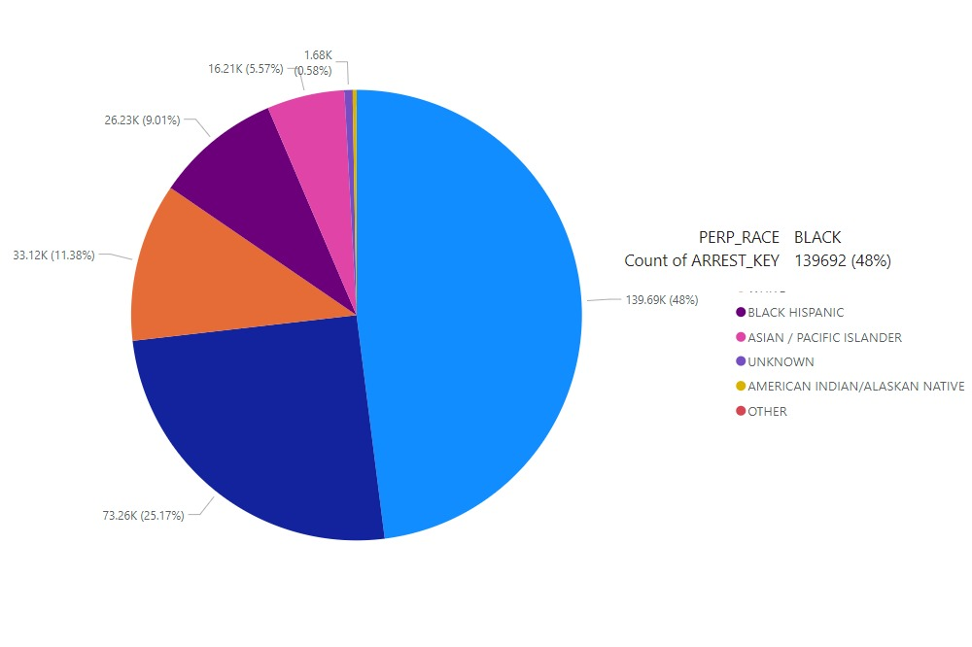
Power BI Visualization - 1

Slide 18
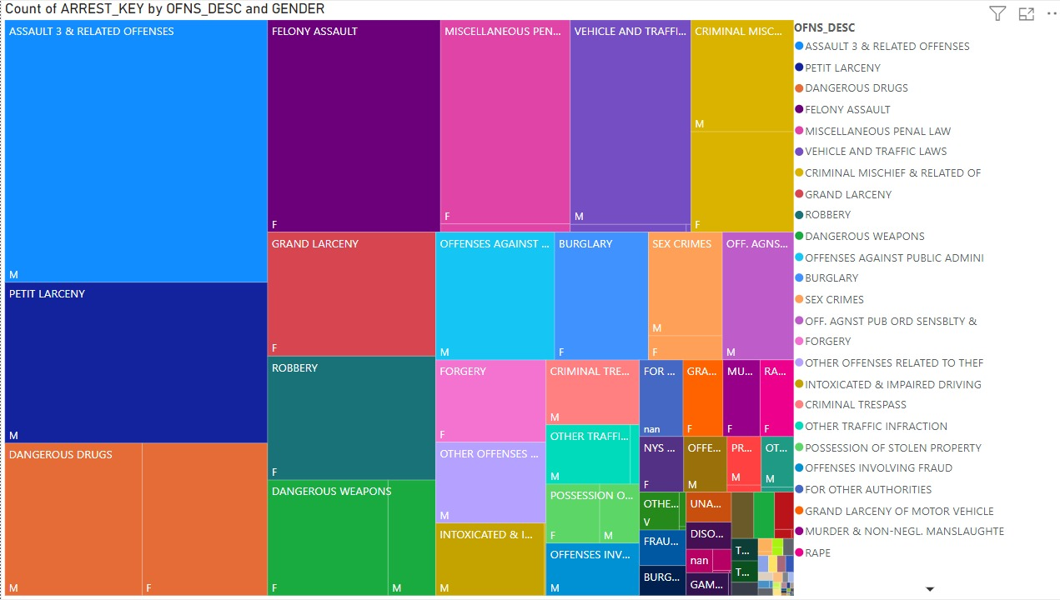
Power BI Visualization - 2

Slide 19
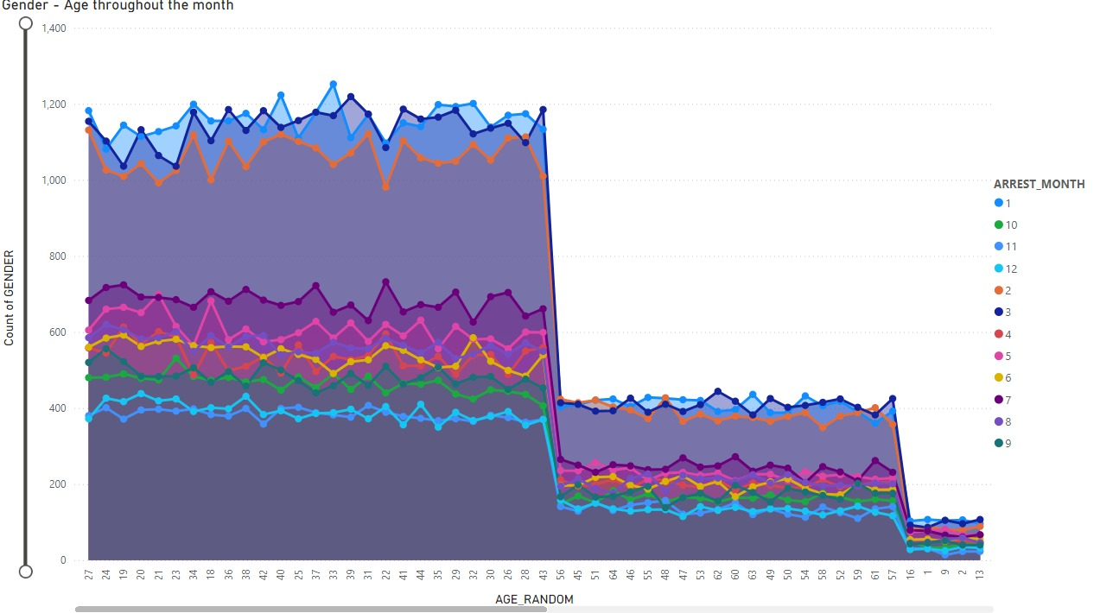
Power BI Visualization - 3

Slide 20
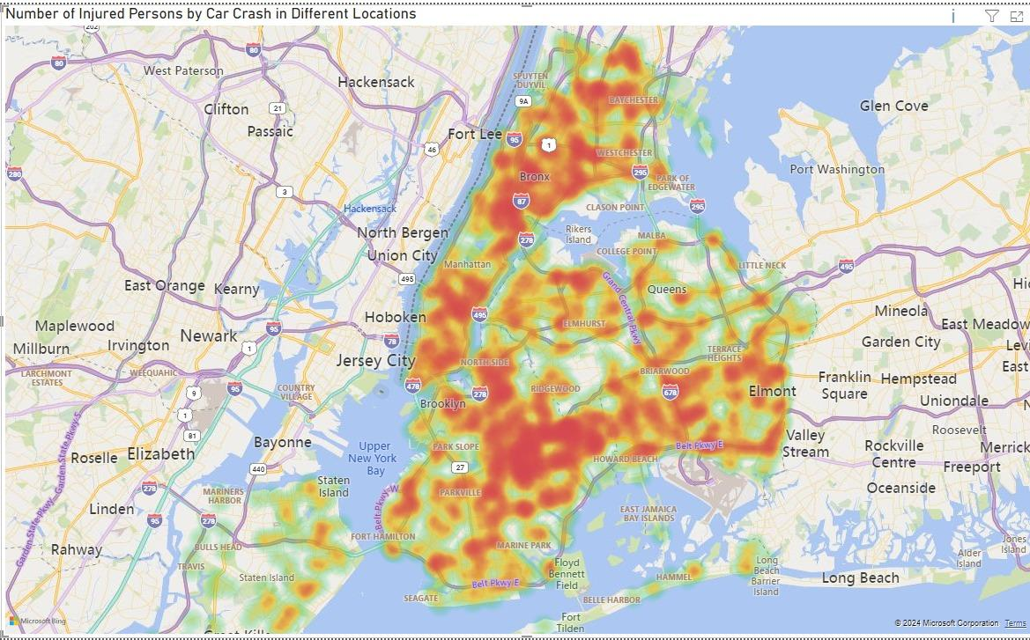
Power BI Visualization - 4

Slide 21
Insights and Recommendations
Insights : NYPD Arrests Data
Identifying trends in types of offenses and demographics (age, gender) of individuals arrested.
Comparing year-to-date trends with historical data to spot any significant changes.
Recommendations : NYPD Arrests Data
Allocate resources based on crime trends to areas or demographics with increasing arrest rates.
Enhance community policing strategies based on identified crime patterns.

Slide 22
Insights and Recommendations
Insights : NYPD Shooting Incident Data (Historic and Year-to-Date)
Identifying hotspots for gun violence and trends in incidence over time.
Analyzing factors contributing to shooting incidents (e.g., location, time).
Recommendations : NYPD Shooting Incident Data (Historic and Year-to-Date)
Implement targeted interventions and community engagement strategies in high-risk areas.
Strengthen gun violence prevention programs and enforcement efforts.

Slide 23
CONCLUSION
In conclusion, the effective utilization of Big Data Tools is essential for managing and analyzing large, complex datasets. This project highlights the integration of data from various sources using tools like Hadoop and Apache Spark, stored in structured databases such as MySQL and MongoDB. Power BI facilitates insightful reporting and visualization of diverse data types. Leveraging these tools for data integration ensures cohesive analysis across multiple sources, enhancing decision-making and strategic planning capabilities based on comprehensive insights.

Slide 24
Thank you

